Slide 1






On-Prem Replica connect with Solution 1.1 and 1.2 DH Upgrade
PostgreSQL read Only replica of GWCP DB
GWCP
AWS direct Connect
DH /IC10.12 On Prem DB
Custom ETL
DH 10.12 On Prem
On Premise
SQL Server 2019
Reports based on DH
BODS ODS DIAL Jobs
TRF BODS Jobs
BODS Extract Jobs
ETL DB
On –Prem Replica GWCP DB

Slide 2
PostgreSQL read Only replica of GWCP DB
GWCP
AWS direct Connect
DH /IC10.12 On Prem DB
Linked DB
DH 10.12 On Prem
On Premise
SQL Server 2019
SQL Server 2019
Reports based on DH
BODS ODS DIAL Jobs
TRF BODS Jobs
BODS Extract Jobs
ETL DB
New Mirror

Slide 3
Direct connect with Solution 1.2 DH Upgrade
PostgreSQL read Only replica of GWCP DB
GWCP
DH /IC10.12 On Prem DB
DH 10.12 On Prem
AWS direct Connect
On Premise
SQL Server 2019
Reports based on DH
BODS ODS DIAL Jobs
TRF BODS Jobs
BODS Extract Jobs

Slide 4
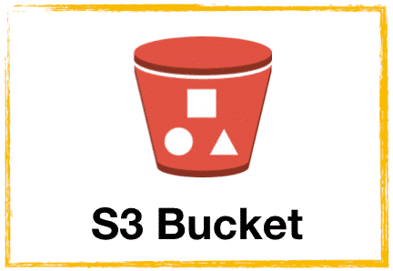

Solution2 – EOR DH Upgrade
GWCP
PostgreSQL read Only replica of GWCP DB
DH 10.12 EOR Region
AWS S3 Bucket with Extract file
EOR - DH 10.12
SAP BODS Extract Job
DH /IC10.12 On Prem DB
DH 10.12 On Prem
On Premise
SQL Server 2019
Reports based on DH
BODS ODS DIAL Jobs
TRF BODS Jobs
Local copy of Extract Files

Slide 5
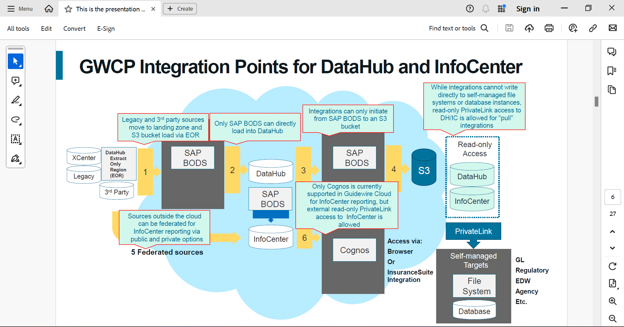

Slide 6




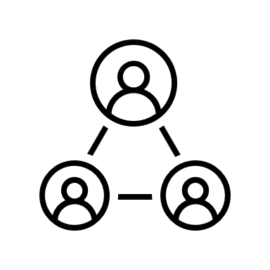
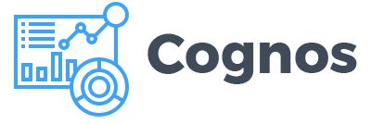
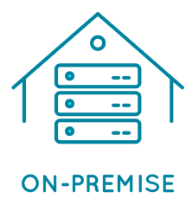

GWCP
3rd Party System
DH EOR Region
Datahub ETL
Legacy System
Datahub DB
SAP BODS Extract Job
Legacy and 3rd party sources move to landing zone S3 bucket via EOR
TRF BODS Jobs
ODS DIAL Jobs
X Center
Infocenter DB
Federated System
InfoCenter ETL
Access with browser or Insurance Suite Integration
Self managed DB
Self managed File System

Slide 7
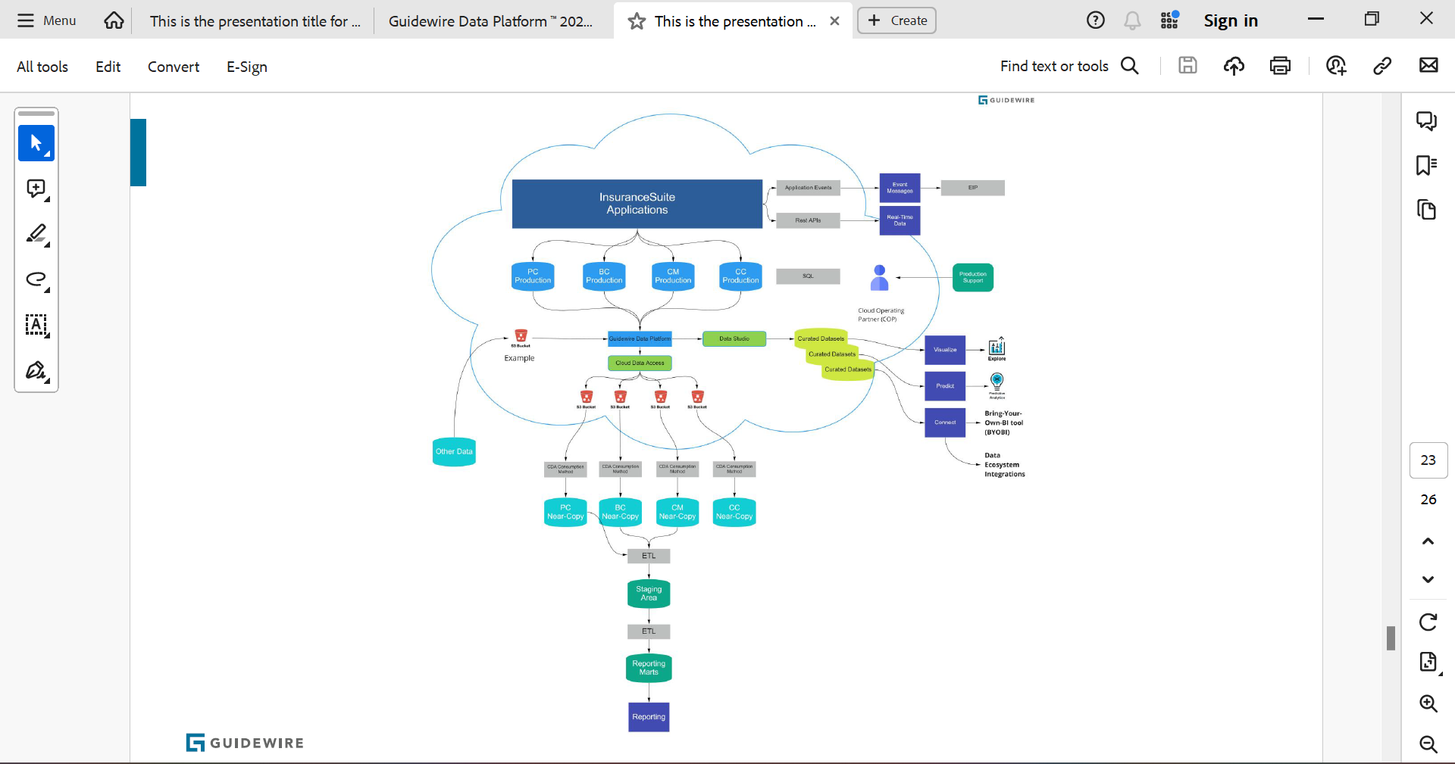
GW Data Future Road map

Slide 8




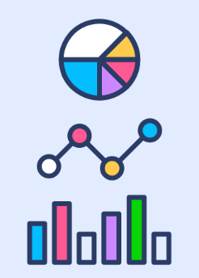



Application Events
Real Time Data
EIP
Insurance Suite Application
Rest API
Event Management
PC production
BC production
PC production
BC production
Production Support
Cloud Operating Partner (COP)
Guidewire Data Platform
Visualized
Data Explore
Cloud Dat Access
Cloud Dat Access
Curated Database
S3 Bucket
Curated Database
Predict
Predictive Analysis
Other Data
Curated Database
Connect
S3
S3
S3
S3
CDA Configuration Method
CDA Configuration Method
CDA Configuration Method
CDA Configuration Method
Bring Your Own BI tool (BYOBI)
PC
Near Copy
BC
Near Copy
CC
Near Copy
CM
Near Copy
Data Ecosystem Integration
Staging DB
Reporting Marts
Staging ETL
Reporting ETL
Report

Slide 9
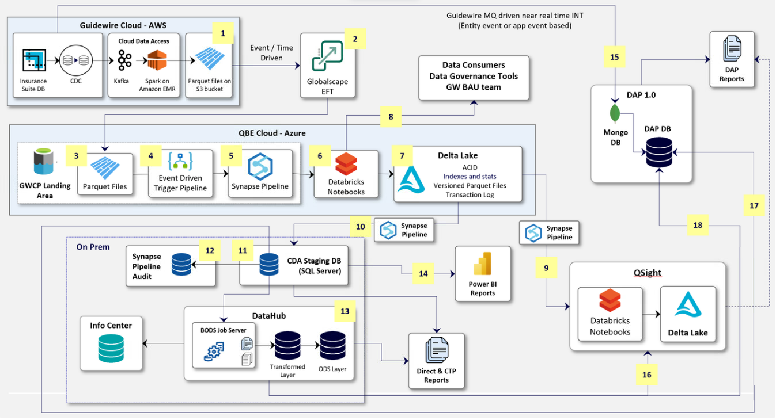
QBE Custom Data soln

Slide 10


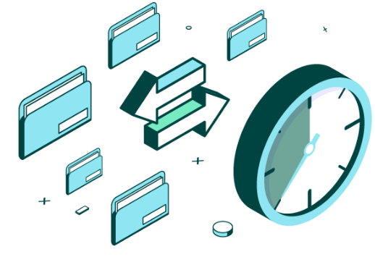
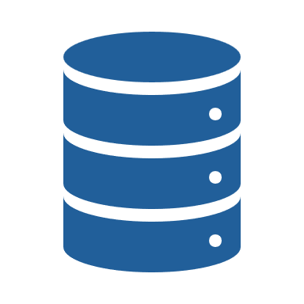


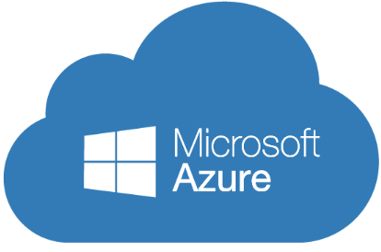
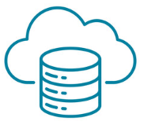
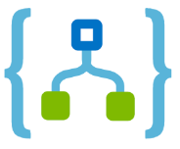
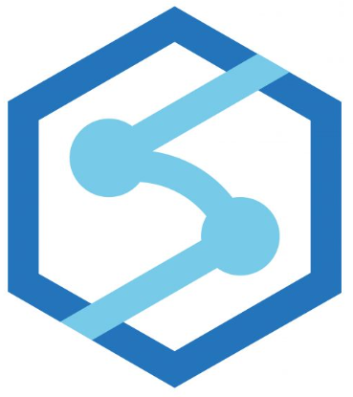
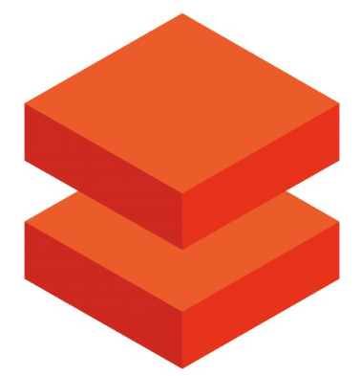


GWCP
Cloud Data Access
Event Time Driven
CDC
Spark on Amazon EMR
Parquet Files on S3
Globalscape EFT
DB
ACID
Indexes and stat Versioned Parquet Files Transaction Logs
GWCP Landing Area
Parquet Files
Event driven trigger
synapse pipeline
Databricks
Delta Lake
Synapse
pipeline
Synapse Pipeline audit
CDA Staging DB SQL Server
DataHub And InfoCenter
Datahub Job Server
DH/IC DB Server
DH DB
EXT+TRF
ODS Jobs
IC DB
Reports
IC Jobs

Slide 11
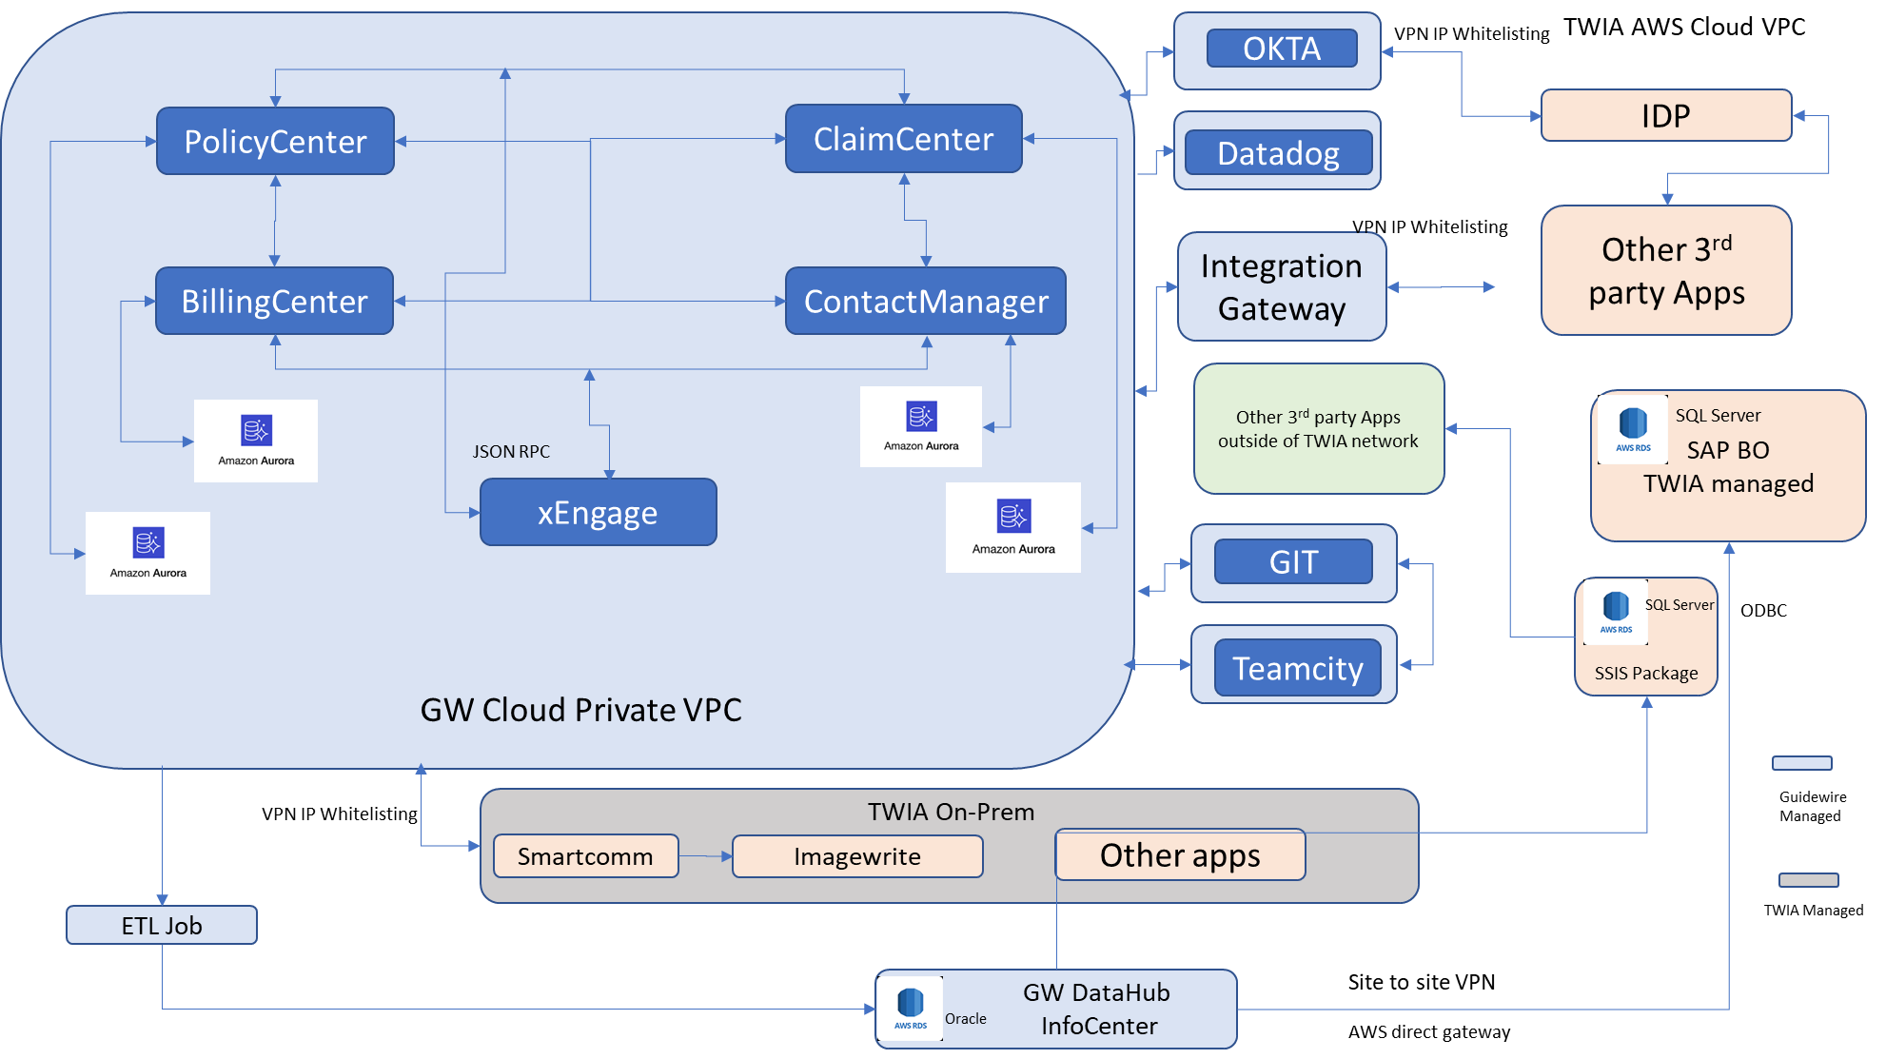
Conceptual Architecture

Slide 12




OCTA
IDP
Datadog
Other 3rd Party Apps
AWS
Arora
Policy Center
Claim Center
AWS
Arora
Integration Gateway
Other 3rd Part Apps outside TWIA Network
AWS
Arora
Billing Center
Contact
Manager
AWS
Arora
GIT
SQL Server SSIS
JSON RPC
X Engage
GW private Cloud VPC
Teamcity
SAP BO TWIA Managed
TWIA ON -Prem
ETL
Smartcomm
Imagewrite
Other Apps
ODBC
Site to Site VPN
AWS Direct Gateway
DataHub InfoCenter

Slide 13
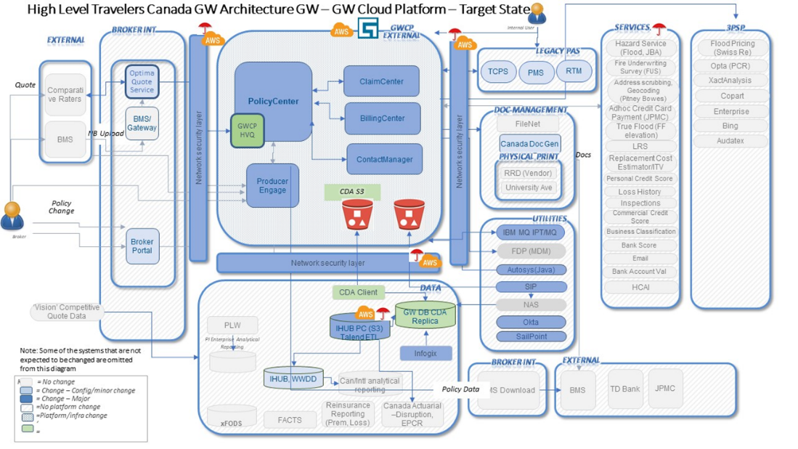
End-To-End - Target State Architecture
Notes:
Key Messages on slide 16,17,18 - Ajith

Slide 14
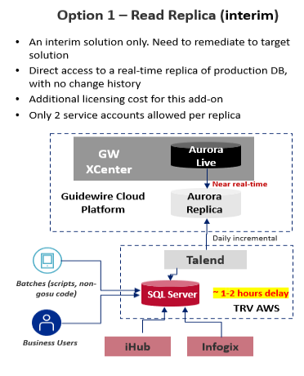
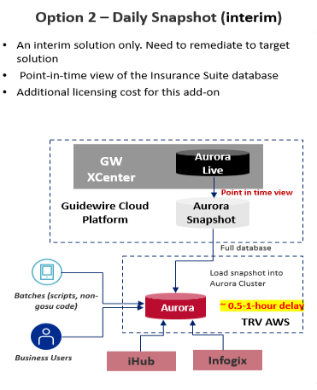
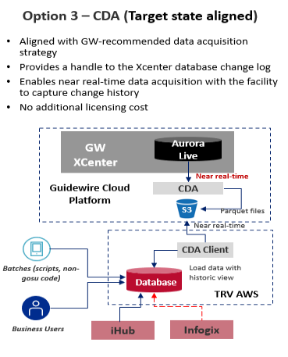
We recommend Option1 for Interim State Data Access Architecture
Comparison Parameters | Option1 (Read Replica) | Option2 (Daily Snapshot) | CDA Reader
Complexity | Simple because real time data replicated in a different DB and available in real time | High because load will take time and chances of failures. | Simple because CDA reader has capability to fetch only delta
 |  | Additional security as Prod data moving from GW cloud to TRV Cloud
Downstream Validation | Required | Required | Required
Low Latency | Y | N | Y
Low Impact on Performance | Y | N | Y
Testing | Only newly added transaction data required to be tested | Full testing required as whole database reloaded | Only newly added transaction data required to be tested
Infra Cost | Additional Replica DB Cost | Very minimal - Storage cost | CDA Reader Hosting cost
Implementation Cost | Lower compared to option 2 | Higher compared to option 1 | Accenture Accelerator
Maintenance Cost | Very minimal- only DB Server Maintenance | DB Server Maintenance cost, GW ticket and resolution cost, Data upload cost | Very minimal- only DB Server Maintenance, CDA Reader hosting cost
Option 1 is recommended as interim state solution due to following key factors:
Complexity, Real time data availability
Low Maintenance
Delay (1-2 hours for option 2) represented for data availability for downstream application consumption are indicative based on experience and assumed solution
Diagram shows how GW data options can be utilized to resolve Travelers’ database challenge
CDA solution highlighted to meet BnR requirements is an option. However, Travelers' data strategy and the Infogix team's design guidelines influence the final end-to-end solutions
Notes:
Key Messages:
Questions on CDA

